Slide 1
The lecture 1
Database concepts

Slide 2
Introduction to databases
Introduction to database systems
Database management systems (DBMS)
Database type
Database Design
Database Design Considerations
Database systems component

Slide 3
Introduction to databases
A database is a program that stores information related to a particular activity or purpose.
Examples: The bank needs to store information related to customer accounts.
The hospital needs to store data on patients and dispensed medications, The university must keep records of its students, An online sales business needs...

Slide 4
Introduction to databases
The database includes tools to help organize and maintain data.
The database design engineer must know and be able to use these tools to make the database efficient and accurate.
In a properly designed database, information is updated once, and all other occurrences in the database will be updated automatically.
A basic requirement for any database system is the ability to efficiently generate, store, and retrieve data.

Slide 5
Basic components of a database system
To transform data into useful information, you need a set of software tools, SQL, Form, etc.

Slide 6
Introduction to databases
Introduction to database systems
Database management systems (DBMS)
Database type
Database Design
Database Design Considerations
Database systems component

Slide 7
Database management systems (DBMS)
A DBMS is a set of software provided by a vendor that allows data to be accessed, filtered, and generally processed efficiently to provide useful information to the user.

Slide 8
Database management systems (DBMS)
Basically, the user will generate a question (request) and the DBMS will look for the answer, which will be returned to the user.
The DBMS will include additional tools for providing graphical user interfaces and reporting programs to facilitate the delivery of information to the user.
It will also provide tools for creating, editing, manipulating and modifying data as well as database programming. SQL is the standard language for accessing relational databases.

Slide 9
What is a database management system?
A database management system (DBMS) is a program that manages a database:
Supports a high level access language (such as SQL).
The application describes database access in this language.
The DBMS interprets the language statements to perform the requested database access.

Slide 10
SQL examples
Example 1:
  SELECT Course_Number
  FROM StudentRecords
  WHERE student_name = ‘ ‘;
Example 2:
  SELECT student_number
  FROM StudentRecords
  WHERE BEngCourse = ‘2388’ AND average_mark >70;
These examples show that SQL is a very useful tool for interrogating a database

Slide 11
Introduction to databases
Introduction to database systems
Database management systems (DBMS)
Database type
Database Design
Database Design Considerations
Database systems component

Slide 12
Types of Database
Classification by user
  Single user databases: Access was initially designed as a single user database
  If Single user database system used for multiple user, there are two problems need to be concern: Data corruption and Performance & Speed.

Slide 13
Database types
Classification by user Single-user databases:
Access was originally designed as a single-user database.
If a single-user database system is used for multiple users, there are two issues to consider: data corruption and performance and speed.

Slide 14
Microsoft Solutions for the Multi-User Market
File server: The Access database is configured as a network share so multiple users can use it at the same time.
Client / Server: Access works as a client, there is MS SQL server on the server side Database Replication: MS Network supports replication through its directory services.
Internet solutions for databases. ASP/Access or ASP/SQL server

Slide 15
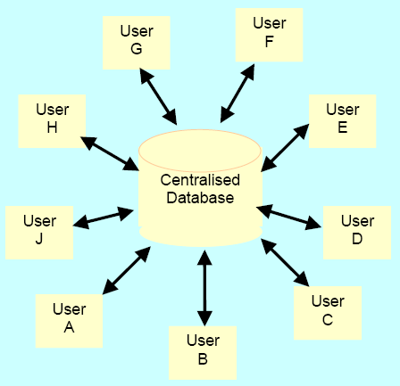
Classification by the location
Centralized Database: In a centralized database system, there is only one database that is shared between users.
Q: What is the main disadvantage of centralized databases? How to solve this problem?
A: Perhaps the main disadvantage of this type of database is that a failure of the server running the database will prevent all users from using the database until the server is back up and running. To solve this problem, larger database applications tend to be of the distributed type.
Q: What is the main disadvantage of centralized databases? How to solve this problem?
A: Perhaps the main disadvantage of this type of database is that a failure of the server running the database will prevent all users from using the database until the server is back up and running. To solve this problem, larger database applications tend to be of the distributed type.

Slide 16
Classification by the location - Distributed Database

Slide 17
Classification by the location Distributed database
A distributed database is commonly found in networks. Here, the current version of the database is stored on different servers. Any changes are replicated over the network, so all copies of the database are up to date.
What are the main disadvantages and disadvantages of distributed databases? The main advantage of such a scheme, perhaps, is fault tolerance. If one of the servers is down, the others can take over the workload. These types of databases are common in enterprise databases.
The main drawback is the cost, both in terms of software licensing and the cost of equipment on the network. In high usage environments, network traffic can also be a problem.

Slide 18
Classification by type
Classification by type distinguishes between a transactional database and a data warehouse. This distinction is quite intuitive since a transactional database is used to process day-to-day information about transactions and keep records of the decisions made with respect to that data.
Due to the fact that many transactions can occur in this database system and that these transactions will influence the decisions made on that day, these types of databases are considered time-critical.
On the other hand, the data warehouse is used to make strategic decisions, and the stored data tends to be longer term.
Therefore, this data is considered NOT time-critical. In terms of the number of applications, a transactional database (also called a production database) is the more common of the two database types.

Slide 19
Classification by type

Slide 20
What is a transaction?
When an event in the real world changes the state of an enterprise, a transaction is executed that causes a corresponding change in the state of the database.
In an interactive database, an event causes a real-time transaction to be executed.
A transaction is an application program with special properties, which will be discussed later, to ensure the correctness of the database.

Slide 21
What is a transaction processing system?
Transaction execution is controlled by the TP monitor
Creates a transaction abstraction, similar to how an operating system creates a process abstraction.
TP Monitor and DBMS together guarantee special properties of transactions
The transaction processing system consists of a transaction monitor, databases, and transactions.

Slide 22
Transaction processing system
DBMS
database
transactions
DBMS
database
TP Monitor

Slide 23
OLTP vs. OLAP
Online Transaction Processing (OLTP)
Day-to-day processing of transactions arising from the operation of the enterprise
Maintains correspondence between database state and enterprise state
Online Analytic Processing (OLAP)
Analysis of information in the database for making managerial decisions

Slide 24
OLAP
Analyzes historical data (terabytes) with complex queries
Due to the volume of data and the complexity of queries, OLAP often uses a data warehouse.
Data warehouse - (offline) storage of historical data generated from OLTP or other sources.
Data Mining is the use of warehouse data to discover relationships that can affect enterprise strategy.

Slide 25
Examples - Supermarket
OLTP
  Event: 3 cans of soup and 1 box of crackers; update database to reflect this event
  OLAP
  Last winter, in all the shops in the northeast, how many shoppers bought soup and crackers together?
  Data aggregation
  Are there any interesting product combinations that customers often buy together?

Slide 26
Introduction to databases
Introduction to database systems
Database management systems (DBMS)
Database type
Database Design
Database Design Considerations
Database systems component

Slide 27
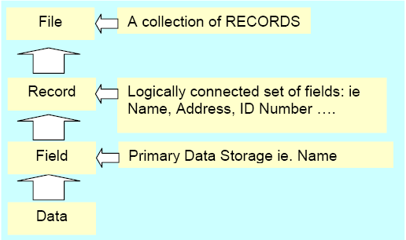
Database design
Very basic level database components

Slide 28
Database design
The design of the database is about how these components are organized, and this determines how effective the design solution will be.
To design a data structure, we need to ask ourselves a few questions, such as:
1. Do we know all the fields we need to include in order for our records and files to contain all the required data?
2. What fields will each of our records contain.
3. Do we allow duplicate fields in records? This will create data redundancy.
4. What records are needed in the files?

Slide 29
Introduction to databases
Introduction to database systems
Database management systems (DBMS)
Database type
Database Design
Database Design Considerations
Database systems component

Slide 30
Database Design Considerations
Data dependency and structural dependency
The data is organized by the designer into a structure that suits their application.
Thus, there is a structural dependency associated with the data in the database. Structural dependency refers to the mechanism for changing the structure of a database. Good database design should ensure that it is relatively easy to make the necessary changes to the structure. For example, adding a field to an existing file structure. dependence on data and deals with the issues of the data itself, not the structure. For example, a data dependency would be related to how easy it is to change a field from, say, an integer to a decimal.

Slide 31
Database design considerations
Data Redundancy Data redundancy is perhaps the most common problem in database design.
This means that the same data is stored in multiple locations. For example, a student's address is stored in the financial file, as well as in the enrollment and examination results file.
Good database design ensures that data is not duplicated in this way. This will save storage space (memory), as well as increase the speed of data access and processing. data integrity refers to the consistency of data that is duplicated.
For example, if our design requires us to maintain a student's email address in several different locations, then failing to update the email address change in all locations will result in data inconsistencies.

Slide 32
Database Design Considerations
Data anomalies Modification, insertion, and deletion anomalies refer to data in a one-to-many relationship.
For example, many students have one personal mentor. So it's a one-to-many relationship and the database will keep a record of the personal tutor for each student. If the tutor's phone number changes because the relationship is one-to-one, all student files must be updated with this new information.
Failure to update will result in a data anomaly, which in this case is called a modification anomaly.
Similarly, we run into problems, like adding a new tutor when needed and removing an old tutor. All student files must be updated accordingly, and failure to do so will result in an insert anomaly or, conversely, a deletion anomaly.

Slide 33
Introduction to databases
Introduction to database systems
Database management systems (DBMS)
Database type
Database Design
Database Design Considerations
Database systems component

Slide 34
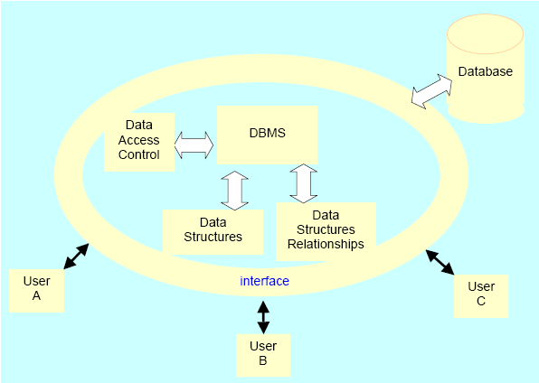
Database systems components

